Slide 1

Devops 2020
Re:Think!
John WIllis and Jabe Bloom
Global Transformation Office

Slide 2
Re:Think
Overview
Organizational Conversations
Organizational Design
The Three Economies

Slide 3
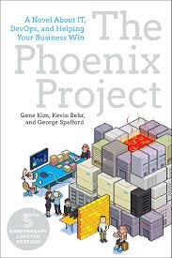
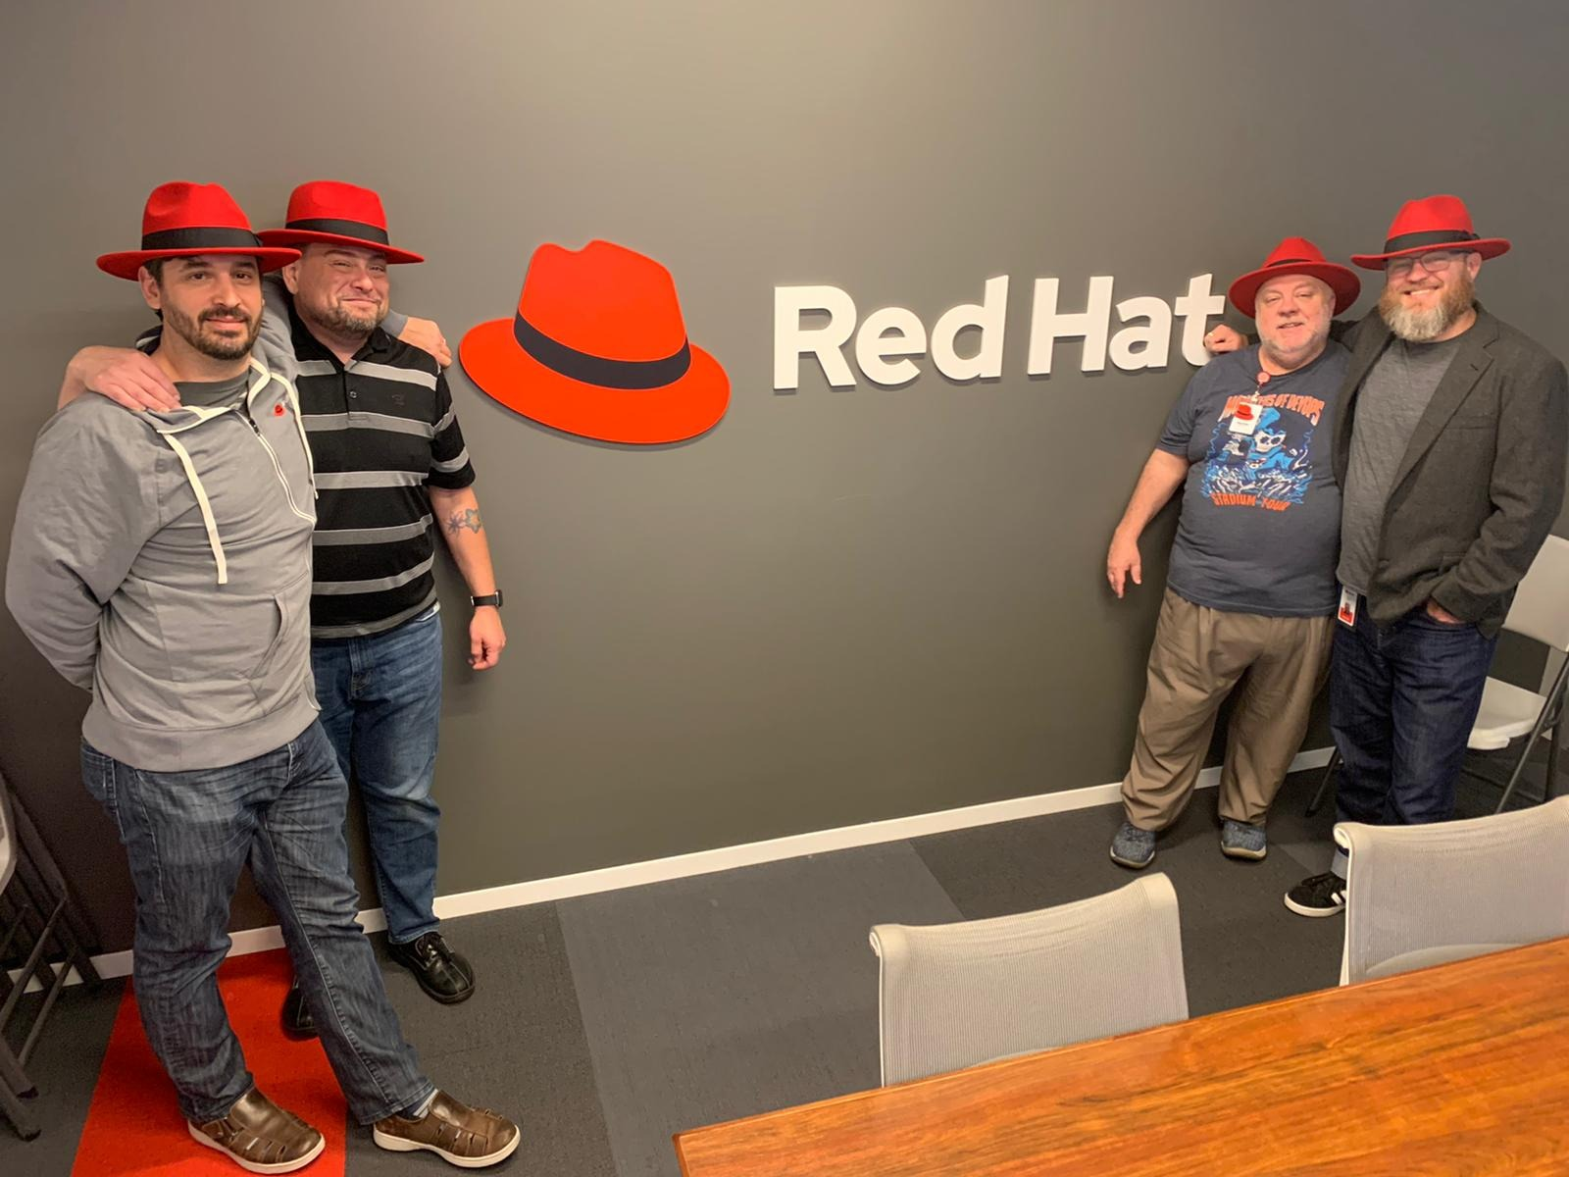
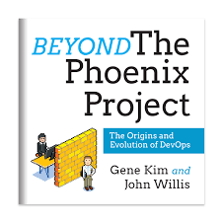
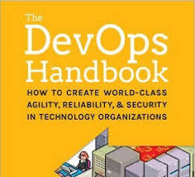
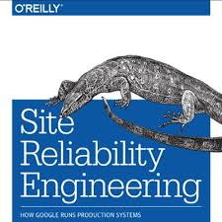
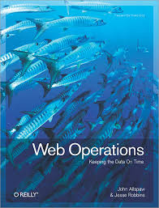

Global Transformation Office
We wrote some books
Notes:
GTO Team books...
Jabe is getting his PHD in “Transition Design at CMU School of Design
Most of the ideas in this presentation come from Jabe’s PhD research...

Slide 4
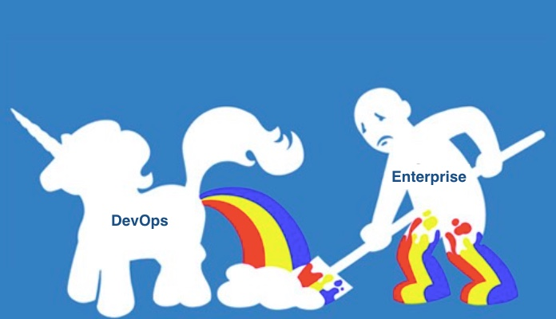
The Last 10 Years

Slide 5
Digital Transformation
“More than 70% of digital transformations fail”
- Peter Bendor-Samuel, Everest Group
Organizations are making technology investments and getting poor results because they aren’t prepared to really change.
Bendor-Samuel, Peter. "Why digital transformations fail: 3 exhausting reasons." Enterpriser’s Project, 27 Aug. 2019, https://enterprisersproject.com/article/2019/8/why-digital-transformations-fail-3-reasons.
Notes:
Johnny what do we have for him under door number 2…
Digital Transformation.

Slide 6
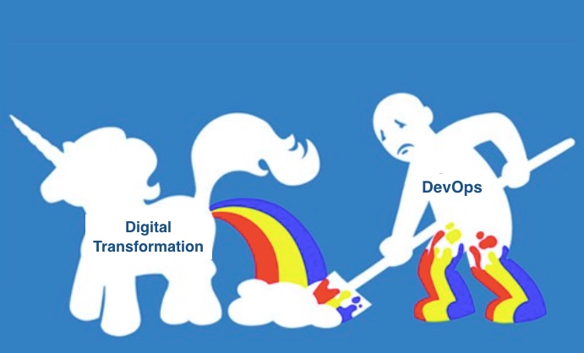
The Next 10 Years

Slide 7





Five Failures
Leadership
Product
Development
Architecture
Operations
Prevents change
Builds things that don’t matter
Builds wrong things
Builds things wrong
Incidents and outages
GTO Engagement Model
Notes:
Basically the last 10 years have been great. We’ve done a great job.
10 years ago I would clients that there were two clubs…
the 3% club (ppl who were doing devops) and the 97% club (ppl who weren't doing devops)
Which club do want to join?
However, now a lot of orgs have caught up.
CI/CD was novel 5 years ago.. Now it’s table stakes.
The RQE… running in the same place.
Gitops in 5 yrs now
We are looking at what devops is going to look like over next 10 years... disruption.
We believe it’s based on Platforms and Design Theory
Two areas that we might be able to move past say gitops...

Slide 8
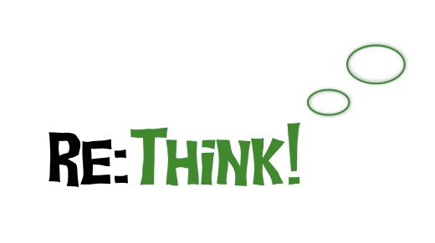
Notes:
Basically the last 10 years have been great. We’ve done a great job.
10 years ago I would clients that there were two clubs…
However, now a lot of orgs have caught up.
CI/CD was novel 5 years ago.. Now it’s table stakes.
Gitops in 5 yrs now
We are looking at what devops is going to look like over next 10 years... disruption.
We believe it’s based on Platforms and Design Theory
Two areas that we might be able to move past say gitops...
Now’s a good time for a rethink… about what we’re doing…
Three areas of suggestions…

Slide 9

Organizational
Conversations
Exploring conversations in the enterprise.
Notes:
The first one is…

Slide 10
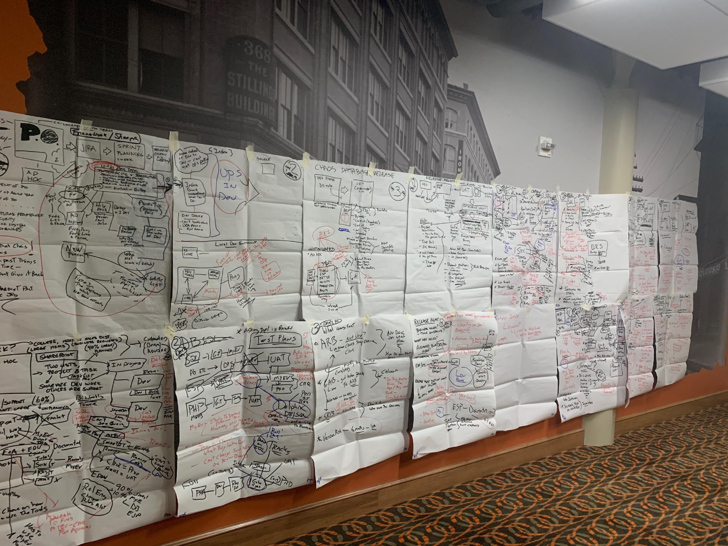
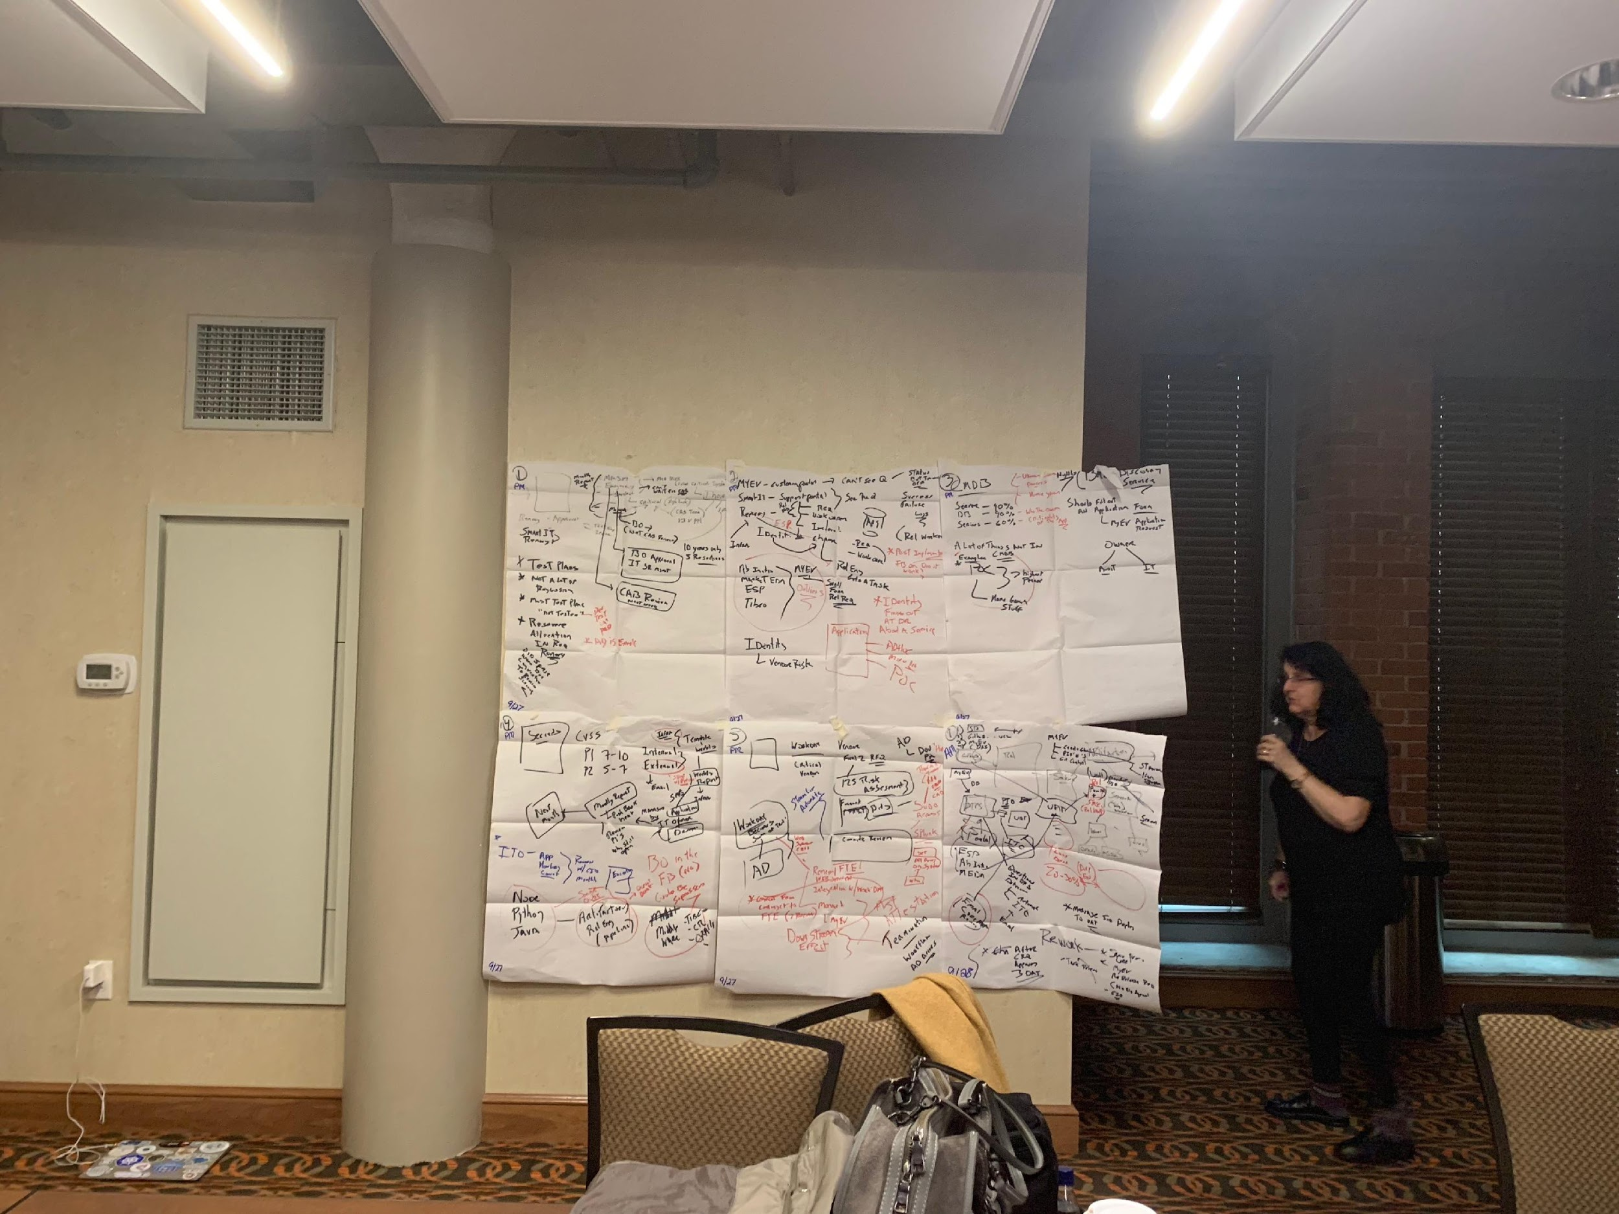
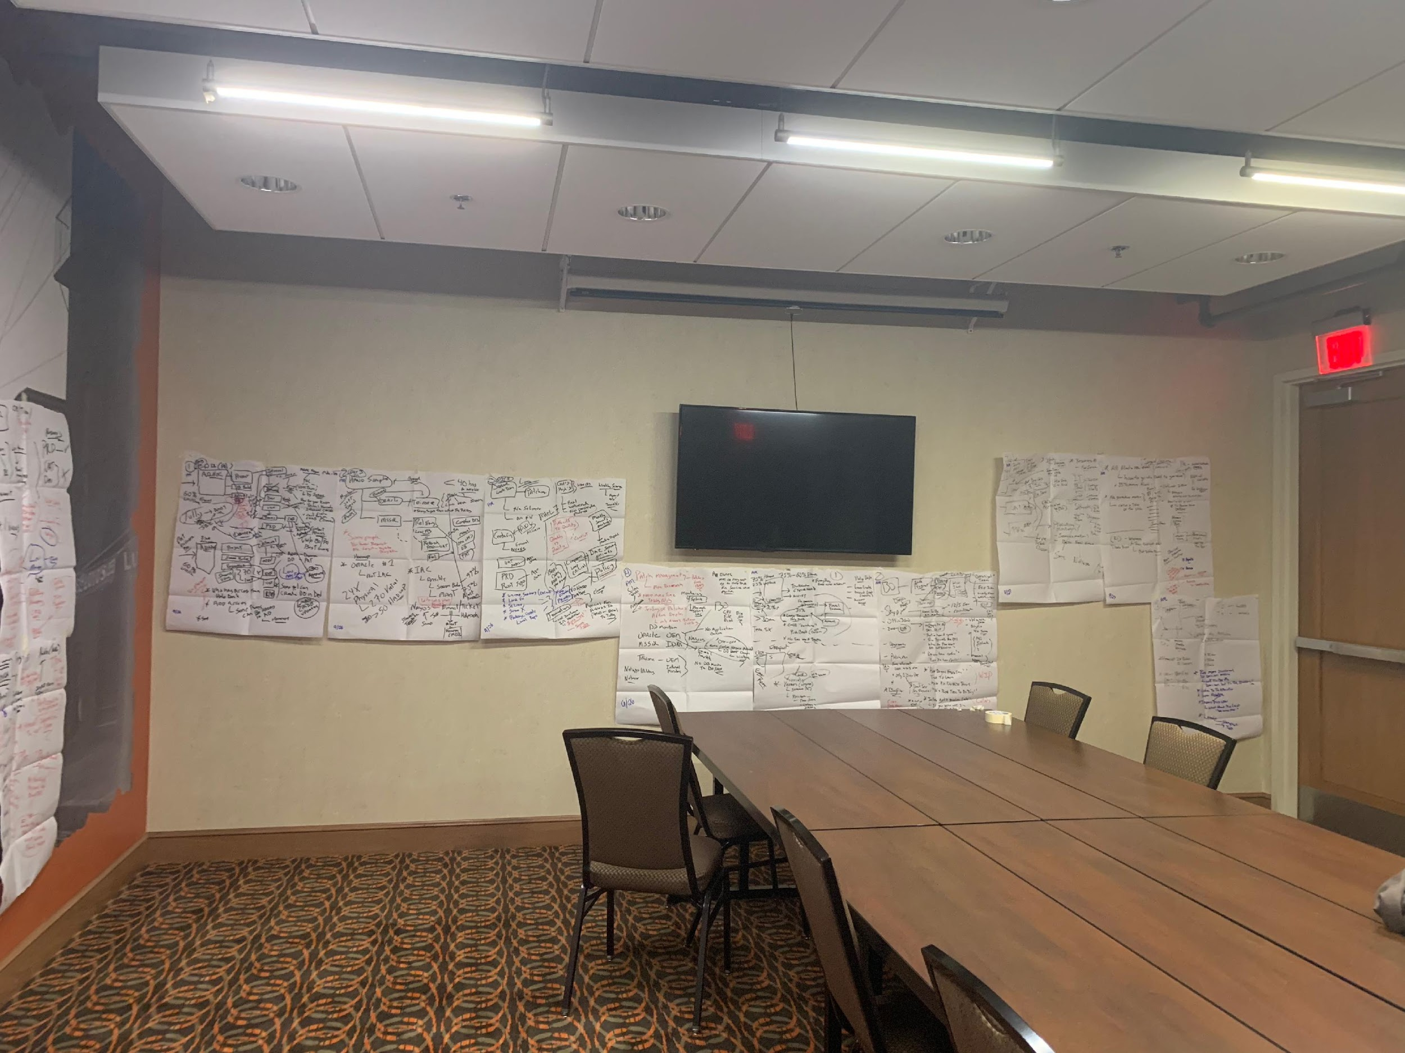
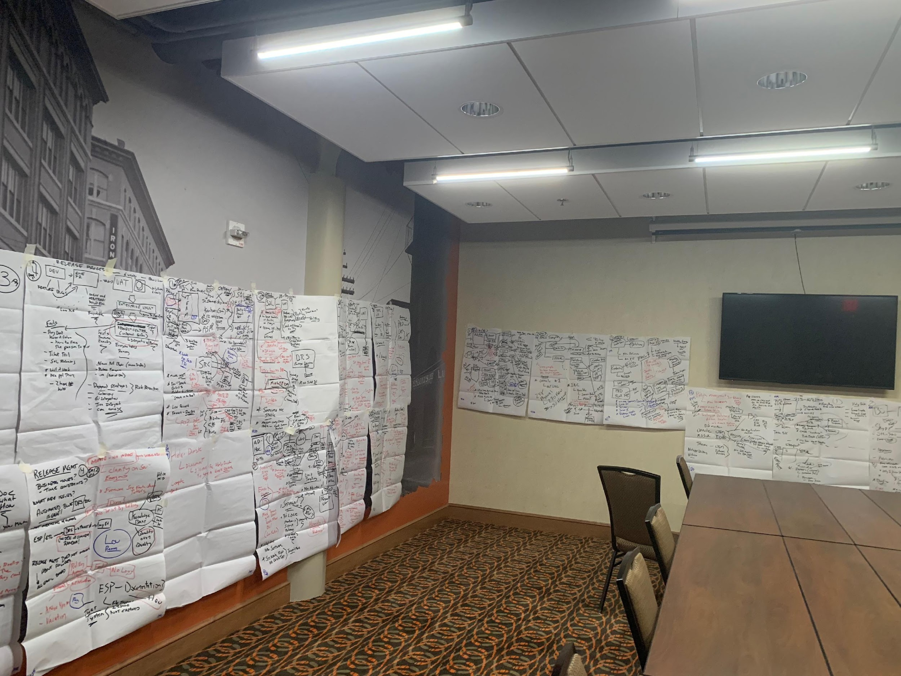
What We Did
Organizational Conversations

Slide 11
You can’t Lean, Agile, SAFe, or even Devops your way around a bad organizational culture.

Slide 12
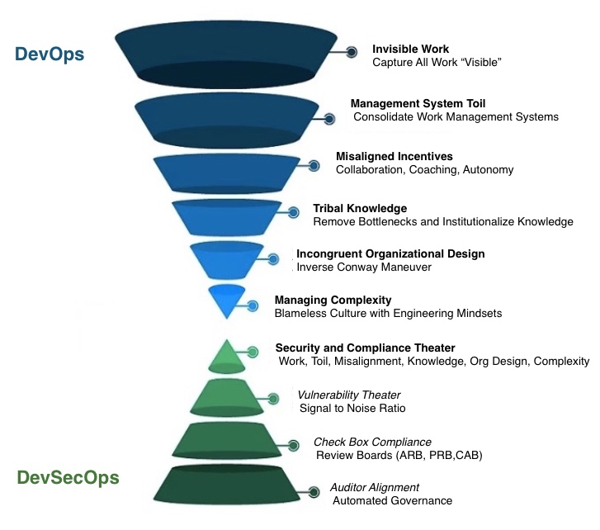

Slide 13
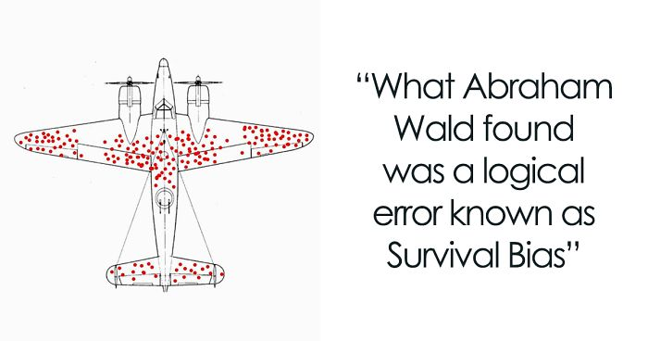
Notes:
Not the absence of negatives; looking for the presence of capacities that make things go right

Slide 14
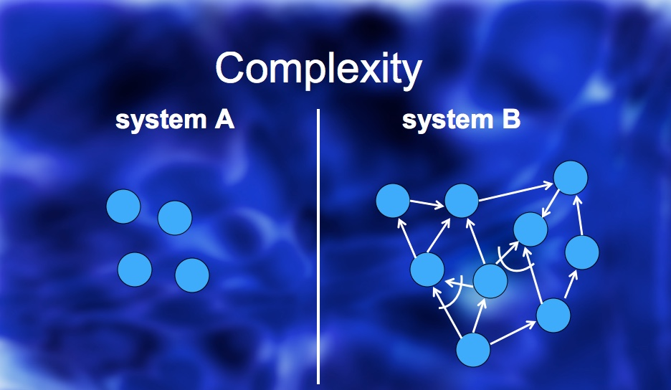
Notes:
Lean agile, devops can create a system b discussion not system a

Slide 15
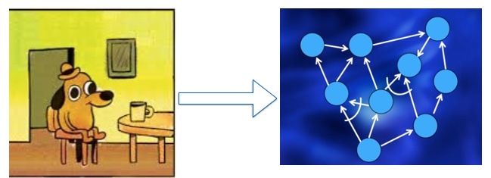
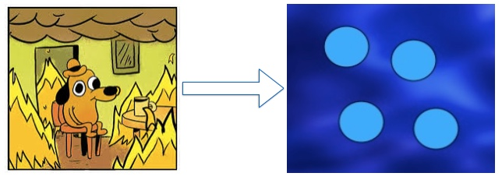
Notes:
abstraction.. devops, lean, agile, safe

Slide 16

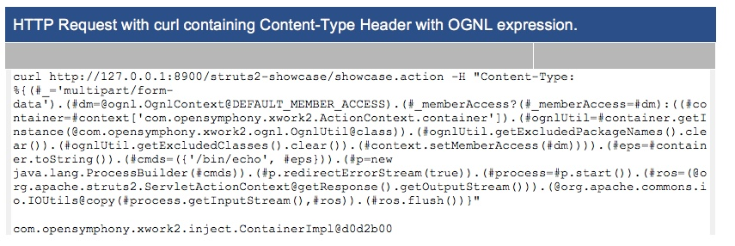
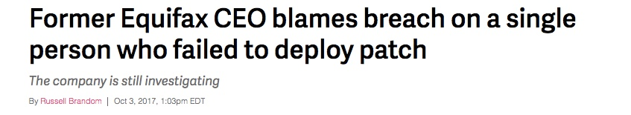

Slide 17
Organizational
Design
Exploring design in the enterprise.
Notes:
(11 mins)
HBR Quote

Slide 18
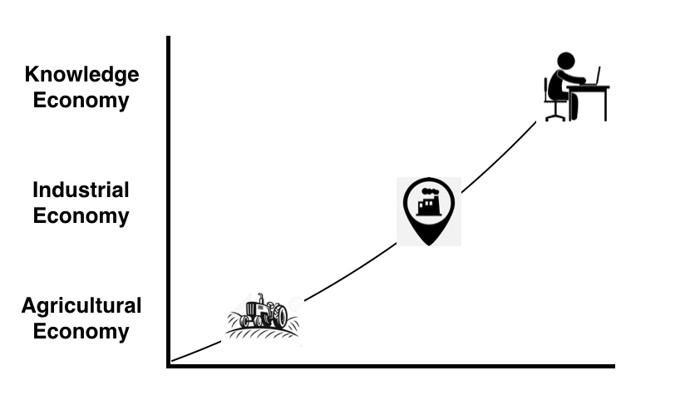
Evolution
Notes:
Still struggle around the IE and KE conversations… what maps what doesn’t map well..

Slide 19
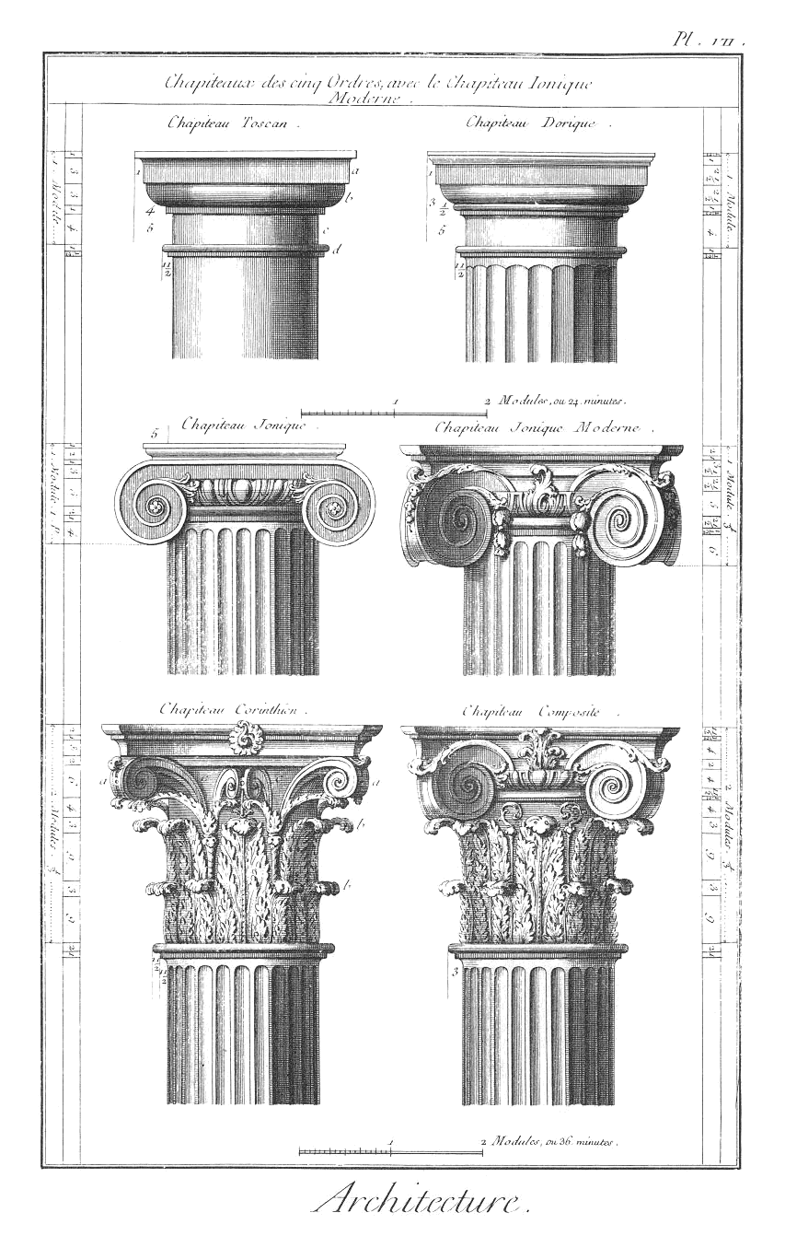
Five Elements
Engineering
Development
Operations
Differentiation
Scale
Leadership
Design
Product
Architecture
Notes:
TPS is great for understanding manufacturing economies; however,
Lean Software Dev has always struggled isomporhic completeness in regards to KNowledge Economies
ACS came up with a tool to better understand LSD as part of knowledge economies.
We use this as cognitive dissonance tool
How to rethink knowledge economics
5 Elements of Learning - balance theory
Modeled after Chineses Medicine (systems thinking)
Pre-Devops the focus was on Dev
Devops the focus was on DevOps dev and ops (eng focus)
Post-Devops (next 10 years) we look at the balance of all of the 5E’s
Arch and Product in most organizations are 20 to 25 years behind eh curve.
Not just dev and ops but eng and design (vertical axis)
Notes:
5E’s are Competencies not Roles..
Leadership
Executive Support for creating a balanced system of increasing strategic optionality.
Product
Working with teams to create strategies for creating and capturing differentiated value by moving from a project-centric to a product-centric mentality.
Development
High quality execution of strategies using aligned tactics, practices, and tools such as agile methodologies and software factories.
Architecture
Creating mission spanning patterns and frameworks, to accelerate product development and ensure long term quality.
Operations
Operational Excellence, establishing a foundation of resilience from unreliable components through adoption of Site Reliability Engineering (SRE) concepts.

Slide 20
Toyota Supply Chain
When we talk about agile, lean or devops all roads always lead back to Toyota. The four V’s of Learning.. Toyota’s used the 4VL as a tool for understanding "economic value" and balance theory..
Variety
Variability
Velocity
Visability
Balance market demands and operational efficiency.
Manage inconsistencies to reduce cost and improve quality.
Steady flow throughout the system..
Transparency to enable continuous learning and improvement.
Notes:
Take IE to KE conversation.

Slide 21
The Opportunities
Five Elements of Learning (5EL) and the Four V’s of Learning (4VL) have different motivations.
Notes:
Can we overlay the 5E with 4VL

Slide 22
Motivations and Conflicts
The following is a mashup of the conflicts and motivations between the Five Elements and the Toyota Supply Chain Four V’s of Learning
Developers and Product want speed and differentiation. While Operations and Architecture want resilience.
Developers | Product | Leadership | Operations | Architecture
Increase | Increase | Increase | Decrease | Decrease
Increase | Increase | Increase | Decrease | Decrease
Increase | Increase | Increase | Decrease | Decrease
Decrease | Decrease | Increase | Increase | Increase
Variety
Variability
Velocity
Visability
Notes:
Developers and Product want Increase on everything except visibility.
Devs and PM’s basically hate being bogged down (GRC, ITIL/ITSM,CAB, Reports, NFR’s) (Decrease VIsibility) - just let me code
Operations and Architecture want Decrease on everything except visibility
Traditional Ops want more evidence (GRC, ITIL/ITSM,CAB, Reports) ( Increase VIsibility)

Slide 23
Variety
Balance market demands and operational efficiency
Exploring theory around the economics balance of choices.
Notes:
Making economic choices…
Think Goldilocks Zone - a balance
losely opinionated.. Should you have 10 pipelines or just one.
Toyota was great at this with their suppliers…
Optionaility…

Slide 24
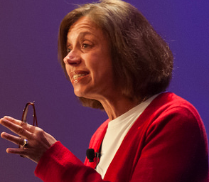
Constraints Enable Freedom
By curtailing the potential variation in component behavior… context-dependent constraints paradoxically also create new freedoms for the overall system
Alicia Juarrero
Notes:
Constraints enable freedom
She studies complex adaptive systems.
Certain types of governance of a system enables freedom for the system.
Notes:
Certain types of governance (curtailing) of a system enables freedom for the system.
Why do we have 26 letters in the alphabet. It’s based on an approximation of sounds of english
This form of governance (only 26 letters) create the profound evolution of the common english language
Think about the 26 letters in the english alphabet. Perfect balance… could have been 36.. 26 has wored out fine.
.

Slide 25
Certain types of governance of a system enables freedom for the system.
.
Notes:
Can we overlay the 5E with 4VL

Slide 26
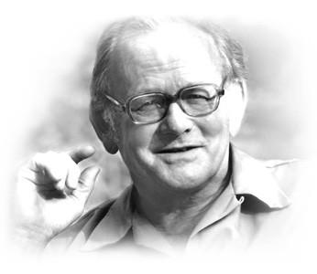
Tragedy of the Commons
Self-interest, behave contrary to the common good of all users by depleting or spoiling the shared resource through their collective action.
Garrett Hardin
Notes:
Consumables must be managed to preserve the system
Too many cows, consume all of the grass, and the field collapses.
Notes:
http://www.recommoning.com/hello-world/
Tragedy of the Commons is another example of an need to curtail variety.
Self-interest, behave contrary to the common good of all users by depleting or spoiling the shared resource through their collective action
Cows… in a field - Too many cows, consume all of the grass, and the field collapses.

Slide 27
Consumables must be managed to preserve the system. Too many cows, consume all of the grass, and the field collapses.
.
Notes:
Can we overlay the 5E with 4VL

Slide 28
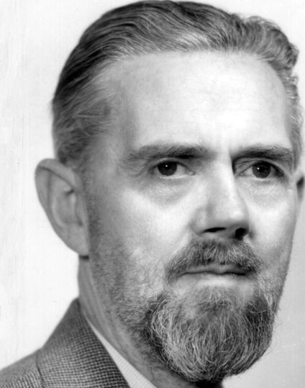
Ashby's Law
If a system its to be stable the number of states of its control mechanism must be greater than or equal to the number of states in the system being controlled
Ross Ashby
Notes:
Stable systems controls must be (>=) then the controlled systems
Ashby’s Law
A constant balancing between controllers and controlled.
Again think platforms...
Notes:
Team A is considered the best team in the league (has one three years in a row)
Team B is a new comer underdog..
They meet in the Championship
If Team A has perfected 5 plays and Team B can only defend 4 of those plays. Team A is probably going to win
Second time two teams play each other
The next year Team B figures out the one play but Team doesn’t improve.. They won last time.. Why change
Now Team B can now defend 5 of those plays. In overtime team A wins (close one)
( Team A they think its a fluke.. They still don’t change)
The next year Team A still doesn't change (why change we won 5 years in a row)
However, the third game Team B now has mastered 6 plays.
If Team B wins.. There’s a new champion…

Slide 29
Stable systems controls must be (>=) then the controlled systems
.
.
Notes:
Can we overlay the 5E with 4VL

Slide 30
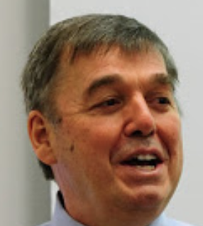
Cost of Delay
The problem with any prioritization decision is [it is a] decision to service one job and delay another.
Don Reinertsen
Notes:
Focus on High Value High Probability Items in your Backlog
Economic prioritization
Gold - these things you are pretty sure have high value
Grene - pretty sure won’t have high value (noisy tail)
Blue - Muddy Middle - do the math...
Find the high value (huge cost of delay) and focus on those first.
Notes:
The thing I like about Z2W is that it has all of the variation economic ideals
However, what I don’t like about Z2W is that it doesn’t use econometrics like TGL,SPC and CoD

Slide 31
Focus on High Value High Probability Items in your Backlog.
.
.
Notes:
Can we overlay the 5E with 4VL

Slide 32
Variety
Variety is a decision making parameter used to balance market demands and operational efficiency. Another way to describe it would be “Optionaility”. .
Constraints
Stability
Constraints enable freedom. Alicia Juarrero
.
Stable systems controls must be (>=) then the controlled systems.
Ross Ashby
Consumables
Cost
Consumables must be managed to preserve the system.
Garrett Hardin
Focus on “High Value” “High Probability” Items in your Backlog. Don Reinertsen

Slide 33
Variability
(Variation)
Using Economic Model for Decision Making
Notes:
(18 mins)
Another lens for Transition Design and Platforms..
http://hrishikeshkarekar.com/2014/10/cost-delay-economic-model-decision-making/

Slide 34
Misunderstanding variation is the root cause of knee-jerk reactions, over control, micromanagement, and tampering.
Unknown

Slide 35
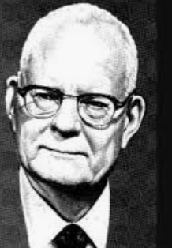
Operations Research
The importance of operational definitions in collecting data. Without them the data is suspect. Change the definition and the data changes. And when you don’t have a written definition the different opinions of those collecting data result in muddled data.
Dr Edwards Deming
Notes:
We quote the hell out of deming.. Let’s start listening to what he said..
SPC

Slide 36
We quote the hell out of Deming. Maybe we should start listening to him.
.
.
Notes:
Spc, pdca, soPk

Slide 37
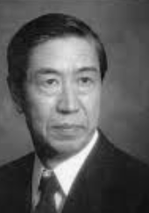
Taguchi Loss Function
Cost is more important than quality but quality is the best way to reduce cost.
Genichi Taguchi

Slide 38
Find the edges of your variability. It’s not how tight your tolerance levels are it’s how far you can stretch them.
Notes:
I’ts not

Slide 39
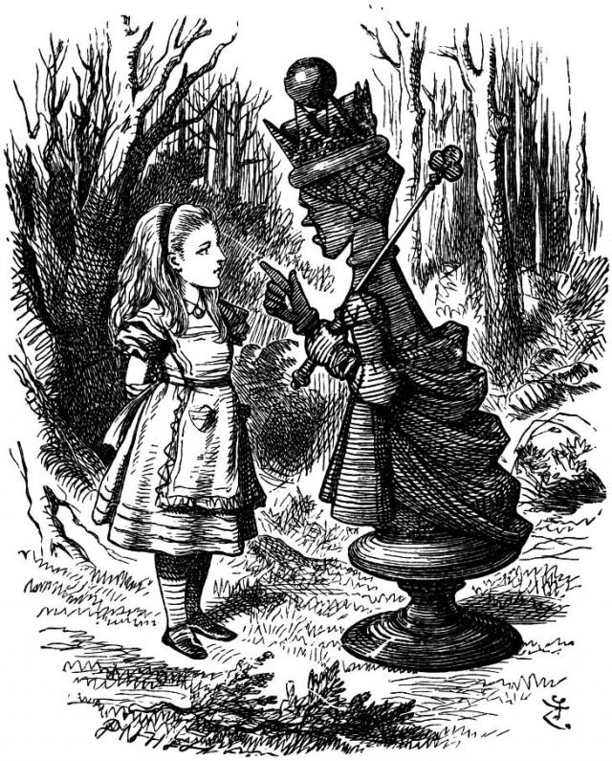
Red Queen Effect
Notes:
Running in the same place is losing
We talked about the RQE earlier
Alice in Wonderland…
Just doing CI/CD for the next 10 years would be running in the same place
What we’re trying to avoid in GTO

Slide 40

Variability
Variability is a decision making parameter used to balance the economics of quality versus cost. Another way to describe it would be “Variation”.
Statistical Process
Hidden Value
Understanding the different types of variation
Shewhart and Deming.
.
Focus on Novel Unknown Unknowns - Differentiation
Inverse Taguchi Curve
Tolerance
Red Queen
Finding the edges of your variability
Genichi Taguchi
Running in the same place is losing
Red Queen Effect

Slide 41
4VL - Summary
Using Math, Engineering, and Statistics.
Instead of Knee-Jerk Fingers in the wind.
If Nuclear Power Plants trust this stuff you should too.
Over 100 Years of Engineering.
Why wait 20 more years...
Notes:
Shewhart create SPC in 1920…
TPS and Toyota's dominance
Pruis vs the Volt.. It’s a joke…
In 1990 Deming said that it would be 50 years before Shewharts contributions would be widely understood and appreciated
(15 mins)

Slide 42
Three Economies
Transition Design for Platforms
Understanding the three economic frameworks that exist in organizations.
Notes:
Transition Design for Platforms...

Slide 43
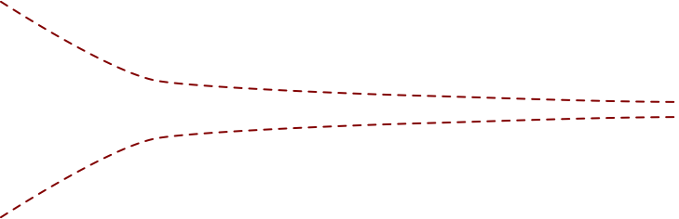
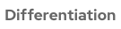
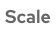
Two Economies (Bi-Model Economy)
Notes:
The classic IT CCC (dff vs scale)
2E historically, but Certainly in the devops era..
Devops has tried to address this gap .. however, at scale even devops has issues.
SRE in the enterprise is another attempt to address this 2E gap.
There’s a cry out for this missing space..

Slide 44
Differentiation
Economy
Velocity
Speed and direction. Getting fast feedback from customers.
Novel
Where organizations look for market advantages.
Create opportunities for disruptive innovation.
Niche
Fast feedback to get product fit.
Experimentation
Fail fast continious experimentation.
Incubation
Invest in disruptive solutions with significant potential impact .

Slide 45
Scale
Economy
Regulate
Regulate velocity,
Reduce
Where organizations optimize for residence and scale.
Variety and Variability
Resilience
Build residence into the system
Reuse
Reuse of components
Consolidation
Consolidate infrastructure

Slide 46
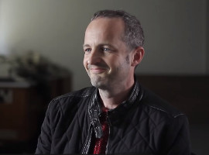
What Google did was make a non-deterministic infrastructure look deterministic to their developers.
Mark Burgess
Notes:
SRE Book forward ..
How do the cloud titans differentiate and scale?
They all built Platforms
Google is the best example
They originally had Borg.. it latter as k8 (openshift)
They created a balance of the 4V’s
Borg was an abstraction between developers and infrastructure.
SRE is the Socio contract and the Platform is the Technical contract.

Slide 47

The Three Economies
Notes:
Scop was asking for someone to explain it..
Remember I said there was this missing gap in our devops story
Basically what Google did was create a third economy…
Borg and SRE are Scope economy constructs
We see Scope is Transition Design

Slide 48
Scope Economy
The Scope economy acts as a clutch. It’s a way of translating efficiency between the difference and scale economies by accelerating adoption..
Differentiation
Scale
Enables Velocity, Variability and Variety..
Controls Velocity, Variability and Variety.
Recommoning
Resilience
Assets increase in value the more there used.
Limits combinatorial complexity.
Notes:
Supports Cloud-Native Patterns

Slide 49
Platforms are the New Kingmakers
Notes:
So where did we end up…
Platforms are the new kingmakers..

Slide 50
Platform by Design
Differentiation Economy
(Container Experience)
Platform as a Service
Scope Economy
(Service Experience)
Platform as an Interface
OpenShift 4
CLUSTER
SERVICES
APP
SERVICES
DEV
SERVICES
Kubernetes
AUTOMATED OPERATIONS
Platform
ENTERPRISE KUBERNETES
SECURE HYBRID CLOUD
Notes:
Platform by design - based on Design Transition
A PaaS is mostly about differentiation .. move fast by managing containers
It’s a lose balance in a 2E model.
Scope/Platform by Design Calibrates the 5E/4VL
Not Paas PaaI
Scope Economy
- Cloud-Native/12 Factor
- ServiceMesh - Resilience through Microsegmentation, Observability, Circuit Breakers, and Chaos Eng
- Recommoning - focus on assets that increase in value the more there used.

Slide 51
Thank you
Red Hat is the world’s leading provider of enterprise open source software solutions. Award-winning support, training, and consulting services make Red Hat a trusted adviser to the Fortune 500.
Notes:
Final Notes: along the way
theory is hard

